Slide 1
Lecture 9
Hash tables
EECS-214

Slide 2
Dictionaries
A.k.a. associative array, map, mapping
Data structure that holds associations between pairs of objects called keys and values
Simplified interface
(we’ll talk more about dictionaries later):
dict.Store(key, value)
  Adds key to dictionary with associated value
  We’ll assume that if the key is already present, this changes its value
dict.Lookup(key)
  Returns value associated with key in dict

Slide 3
Implementing dictionaries with association lists
The simplest possible implementation of dictionaries is as a linked list of key/value pairs
Each cell has three fields
  Key
  Value
  Link to next cell
a
5
b
-2
c
4.2

Slide 4

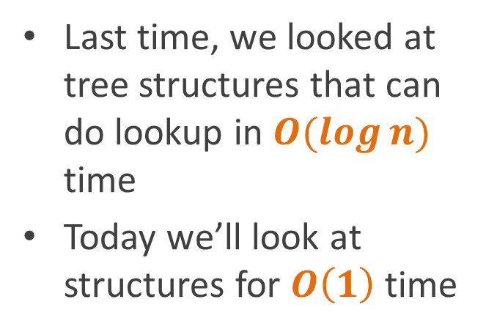
Implementing dictionaries with association lists
This isn’t a great representation because lookup requires $O\left(n\right)$ time
Last time, we looked at tree structures that can do lookup in $O(\log{n)}$ time
Today we’ll look at structures for $O\left(1\right)$ time
a
5
b
-2
c
4.2

Slide 5
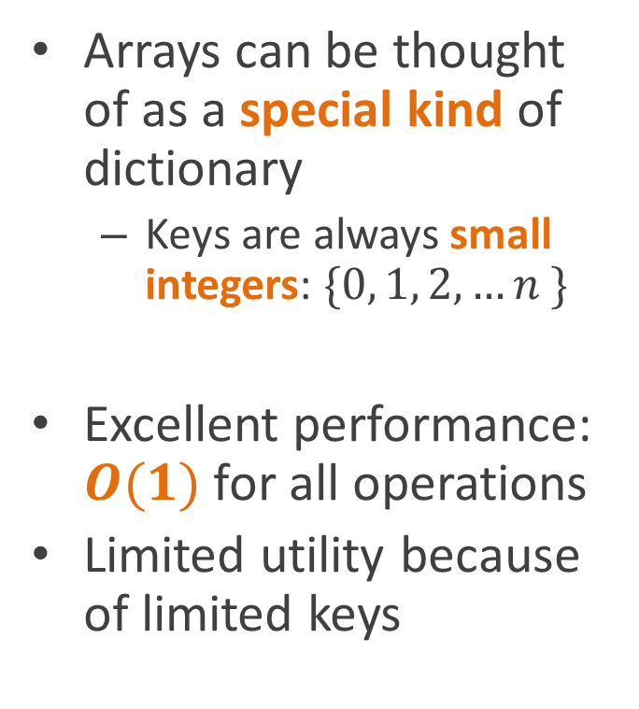
Arrays as dictionaries
Arrays can be thought of as a special kind of dictionary
  Keys are always small integers: $\{0, 1, 2, …n \}$
Excellent performance: $O(1)$ for all operations
Limited utility because of limited keys

Slide 6
why can’t everything be like arrays?

Slide 7
Direct addressing
Assign numbers to all possible keys in advance
Make an array as big as the set of all keys
Store value associated with key in array slot corresponding to the key’s number
  Value associated with Monday is in a[2]
Key | Integer
Saturday | 0
Sunday | 1
Monday | 2
Tuesday | 3
Wednesday | 4
Thursday | 5
Friday | 6
Sat
Sun
Mon
Tue
Wed
Thur
Fri

Slide 8
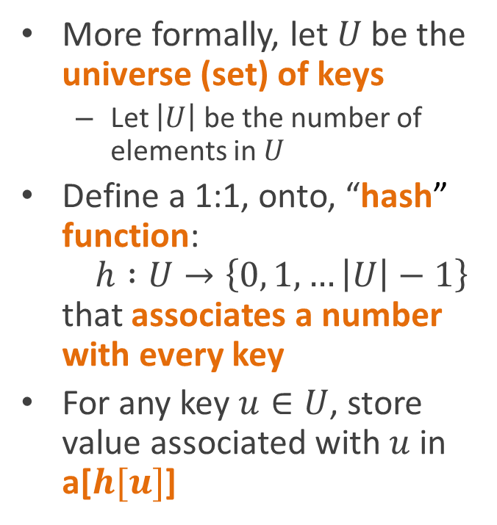

Direct addressing
$$U$$
More formally, let $U$ be the universe (set) of keys
  Let $\left|U\right|$ be the number of elements in $U$
Define a 1:1, onto, “hash” function:
$h :U→\left\{0, 1, …\left|U\right|−1\right\}$
that associates a number with every key
For any key $u∈U$, store value associated with $u$ in a[$h[u]$]
…

Slide 9
Direct addressing
$$U$$
The array is as big as the key space
This is a problem when
  The dictionary is sparse (many fewer entries than possible keys)
  The key space is infinite
keys in use
…

Slide 10
Direct addressing
$$U$$
What if we just use a smaller array and hope for the best?
keys in use
…

Slide 11
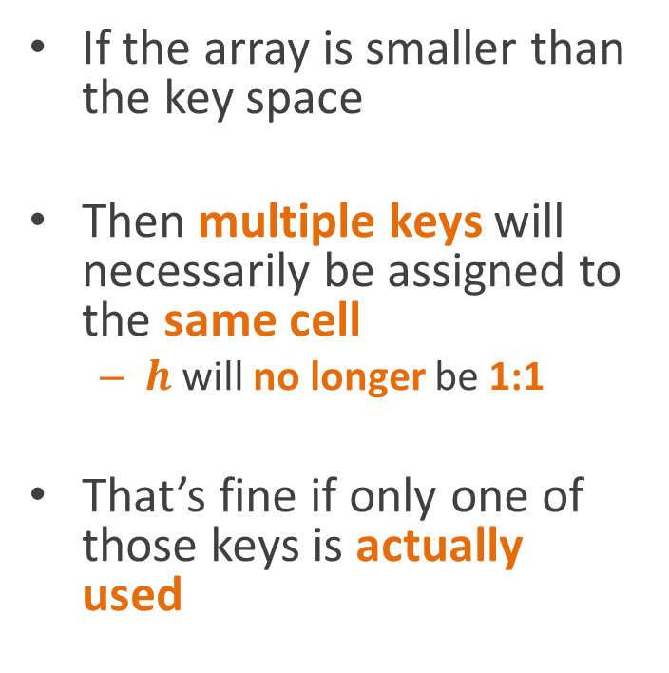
Shrinking the array
$$U$$
If the array is smaller than the key space
Then multiple keys will necessarily be assigned to the same cell
  $h$ will no longer be 1:1
That’s fine if only one of those keys is actually used
keys in use
…

Slide 12

Hash tables
$$U$$
A hash table is a dictionary data structure that
  Maps keys into an $m$ element array
    Where $m≪\left|U\right|$
    (“$≪$” means “much less than”)
  Using a hash function $h :U→\{0, 1, …m−1 \}$
  Designed to distribute keys uniformly over array cells
    a.k.a. hash buckets
keys in use
…

Slide 13
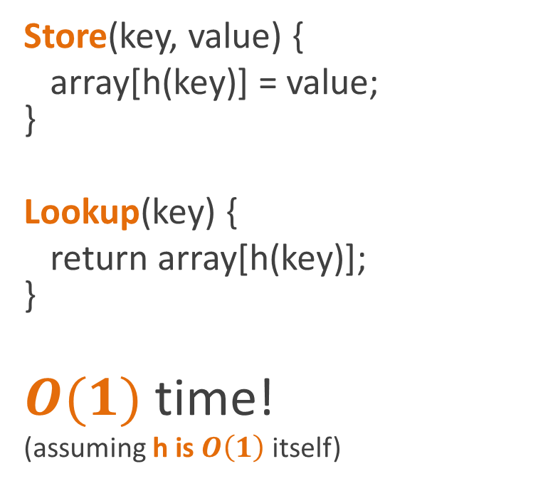
Hash tables
$$U$$
Store(key, value) {
array[h(key)] = value;
}
Lookup(key) {
return array[h(key)];
}
$O(1)$ time!
(assuming h is $O\left(1\right)$ itself)
keys in use
…

Slide 14
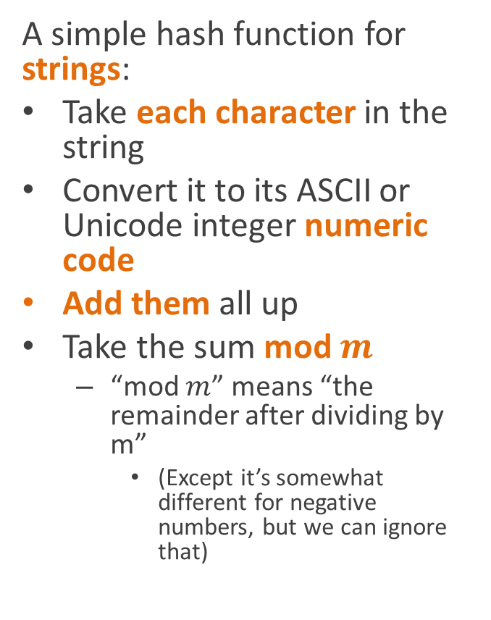
Example hash function
A simple hash function for strings:
Take each character in the string
Convert it to its ASCII or Unicode integer numeric code
Add them all up
Take the sum mod $m$
  “mod $m$” means “the remainder after dividing by m”
    (Except it’s somewhat different for negative numbers, but we can ignore that)
int BadHash(string s) {
int sum = 0;
foreach (char c in s)
sum += (int)c;
return sum%tableSize;
}

Slide 15
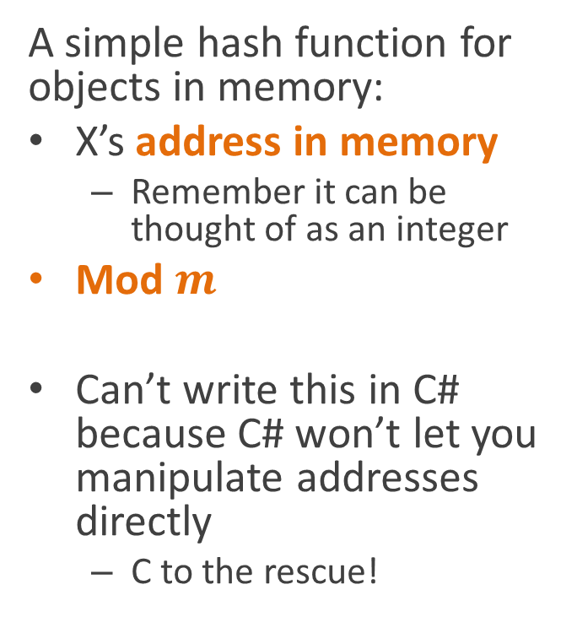
Example hash function
A simple hash function for objects in memory:
X’s address in memory
  Remember it can be thought of as an integer
Mod $m$
Can’t write this in C# because C# won’t let you manipulate addresses directly
  C to the rescue!
int AddressHash(void *x) {
return ((int)x)%tableSize;
}
Note: in practice addresses are usually multiples of 4 (for 32 bit machines) or 8 (for 64 bit machines)
So in real life, you’d use the address divided by 4 or 8
  Or right-shift by 2 or 3 bits, respectively
So hash functions often look like:
  ( ((unsigned int)x)>>2)%tableSize
  ( ((unsigned int)x)>>3)%tableSize

Slide 16
Collisions
$$U$$
Great!
But what if two keys in actual use get mapped to the same array slot?
  We have a collision
keys in use
…

Slide 17
Chaining
The easy solution to this is to store a small linked list dictionary in each array cell
  Stores just the key/value pairs for those keys in use that map to that particular array cell

Slide 18

Is this $O(1)$?
Store(key, value) {
array[h(key)].Store(key, value);
}
Lookup(key) {
return
array[h(key)].Lookup(key);
}

Slide 19
Is this $O(1)$?
Store(key, value) {
array[h(key)].Store(key, value);
}
Lookup(key) {
return
array[h(key)].Lookup(key);
}
No!

Slide 20
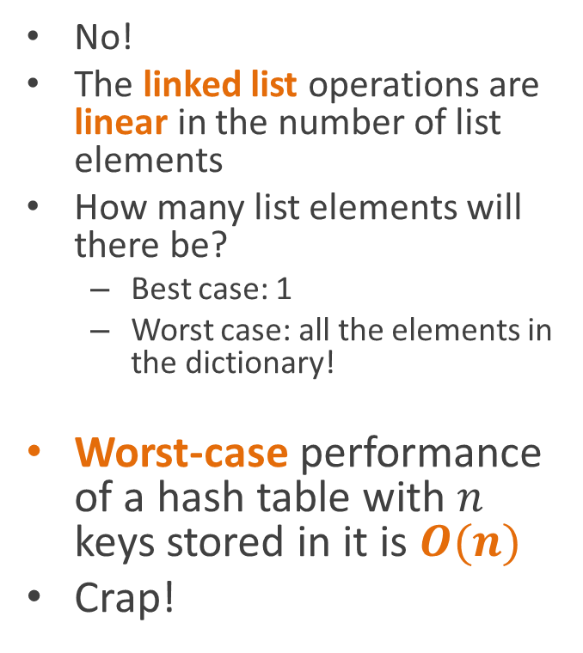
Is this $O(1)$?
No!
The linked list operations are linear in the number of list elements
How many list elements will there be?
  Best case: 1
  Worst case: all the elements in the dictionary!
Worst-case performance of a hash table with $n$ keys stored in it is $O(n)$
Crap!

Slide 21
Average-case performance
In practice, hash tables generally perform well
So how do we explain that theoretically?

Slide 22
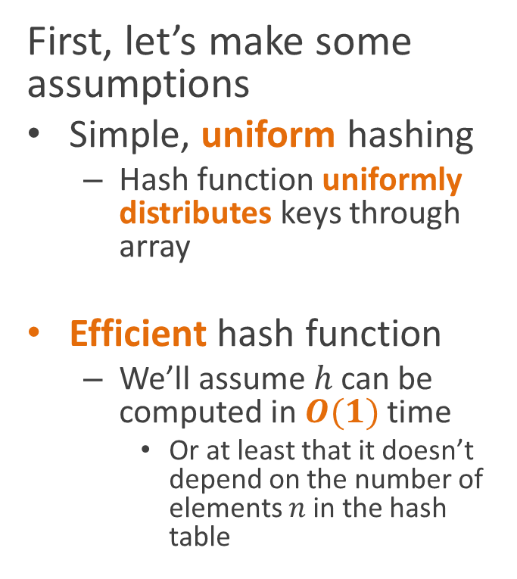
Average-case performance
First, let’s make some assumptions
Simple, uniform hashing
  Hash function uniformly distributes keys through array
Efficient hash function
  We’ll assume $h$ can be computed in $O(1)$ time
    Or at least that it doesn’t depend on the number of elements $n$ in the hash table

Slide 23
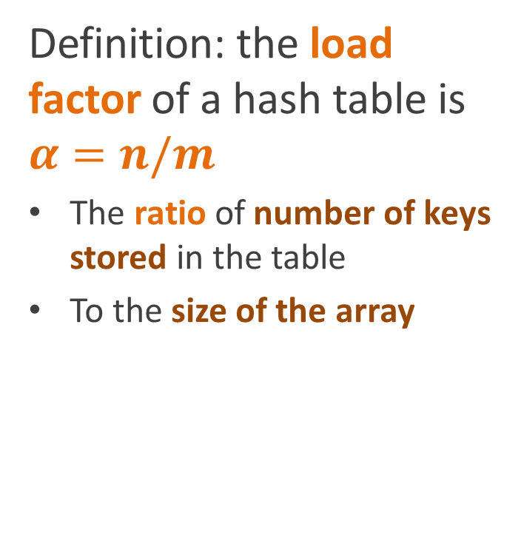
Average-case performance
Definition: the load factor of a hash table is $α=n/m$
The ratio of number of keys stored in the table
To the size of the array

Slide 24

Average-case performance
Theorem 1: an unsuccessful search takes time $Θ(α+1)$ on average

Slide 25
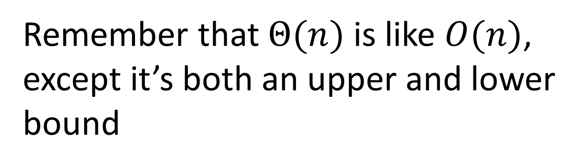
Remember that $Θ(n)$ is like $O(n)$, except it’s both an upper and lower bound
So it’s a stronger assertion

Slide 26
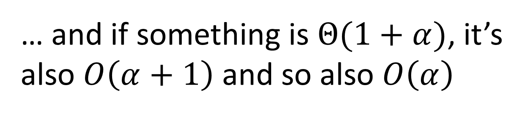
… and if something is $Θ(1+α)$, it’s also $O\left(α+1\right)$ and so also $O\left(α\right)$

Slide 27
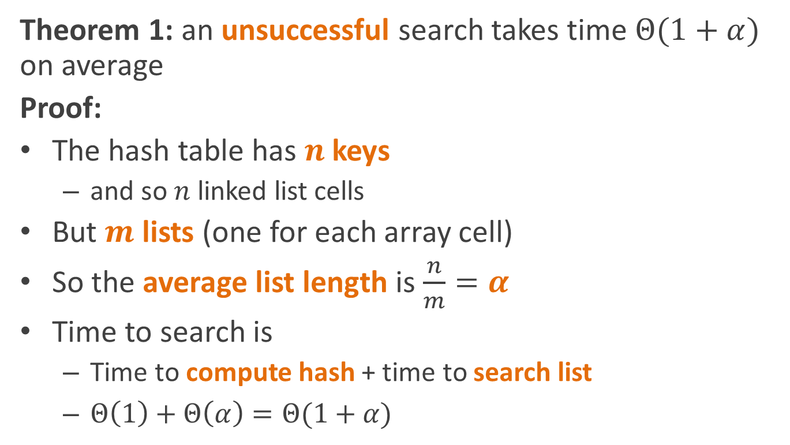
Average-case performance
Theorem 1: an unsuccessful search takes time $Θ(1+α)$ on average
Proof:
The hash table has $n$ keys
  and so $n$ linked list cells
But $m$ lists (one for each array cell)
So the average list length is $\frac{n}{m}=α$
Time to search is
  Time to compute hash + time to search list
  $Θ\left(1\right)+Θ\left(α\right)=Θ(1+α)$
Why do they say $Θ\left(1+α\right)$ rather than just $Θ\left(α\right)$? Because they want to make clear That execution time never goes to zero even when n is zero.

Slide 28
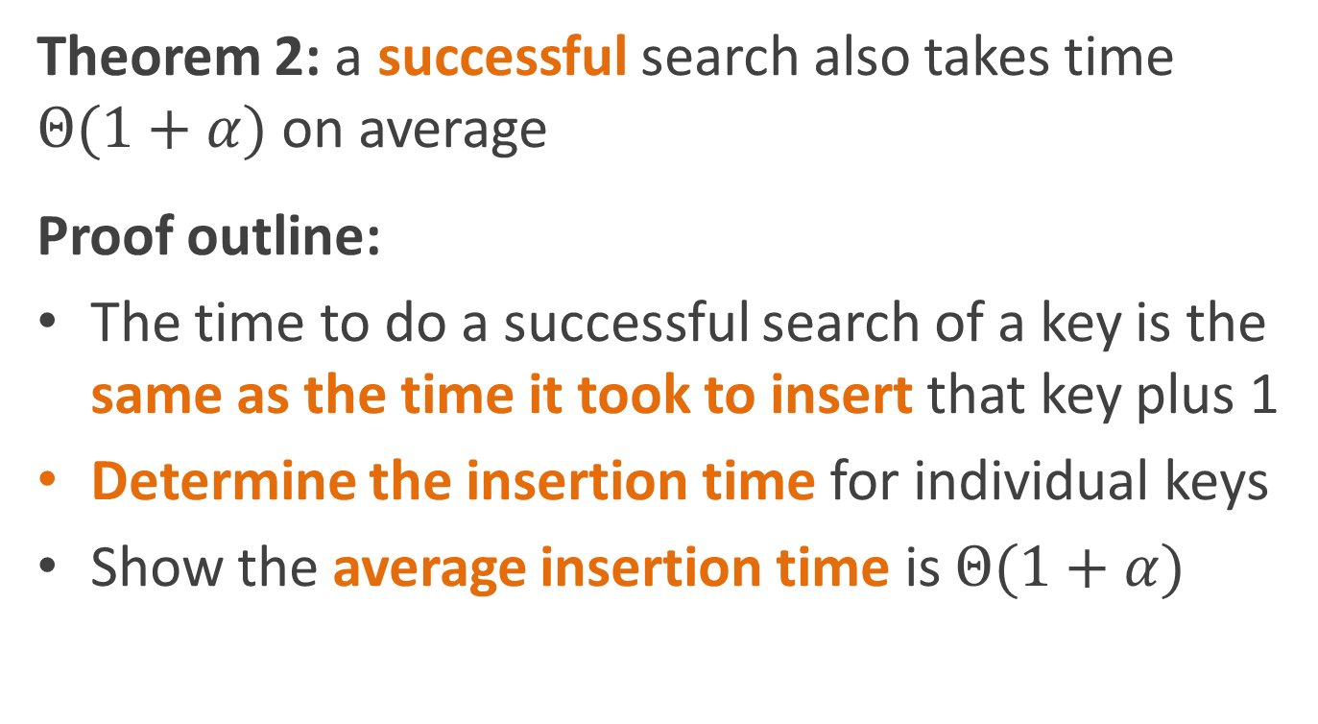
Average-case performance
Theorem 2: a successful search also takes time $Θ(1+α)$ on average
Proof outline:
The time to do a successful search of a key is the same as the time it took to insert that key plus 1
Determine the insertion time for individual keys
Show the average insertion time is $Θ(1+α)$

Slide 29
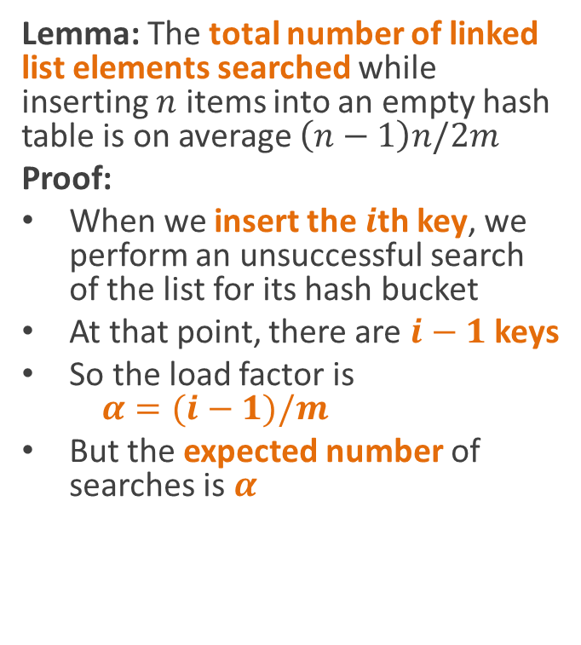
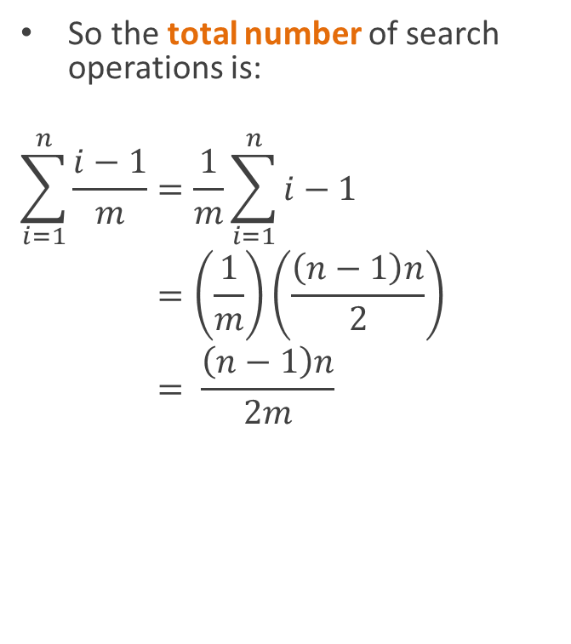
Average-case performance
Lemma: The total number of linked list elements searched while inserting $n$ items into an empty hash table is on average $\left(n−1\right)n/2m$
Proof:
When we insert the $i$th key, we perform an unsuccessful search of the list for its hash bucket
At that point, there are $i−1$ keys
So the load factor is
$α=(i−1)/m$
But the expected number of searches is $α$
So the total number of search operations is:
$$\sum_{i=1}^{n}{\frac{i−1}{m}}=\frac{1}{m}\sum_{i=1}^{n}{i−1} \\ =\left(\frac{1}{m}\right)\left(\frac{\left(n−1\right)n}{2}\right) \\ = \frac{\left(n−1\right)n}{2m}$$

Slide 30
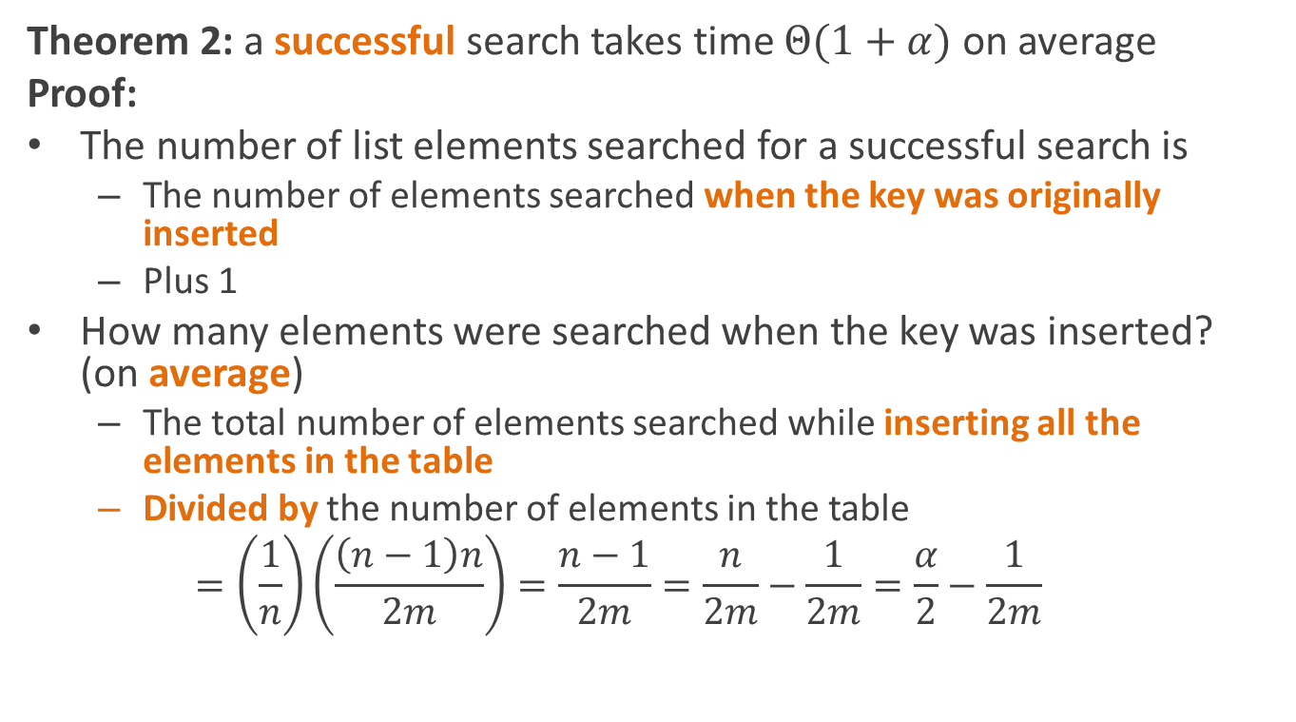
Average-case performance
Theorem 2: a successful search takes time $Θ(1+α)$ on average
Proof:
The number of list elements searched for a successful search is
  The number of elements searched when the key was originally inserted
  Plus 1
How many elements were searched when the key was inserted? (on average)
  The total number of elements searched while inserting all the elements in the table
  Divided by the number of elements in the table
  $$=\left(\frac{1}{n}\right)\left(\frac{\left(n−1\right)n}{2m}\right)=\frac{n−1}{2m}=\frac{n}{2m}−\frac{1}{2m}=\frac{α}{2}−\frac{1}{2m}$$

Slide 31
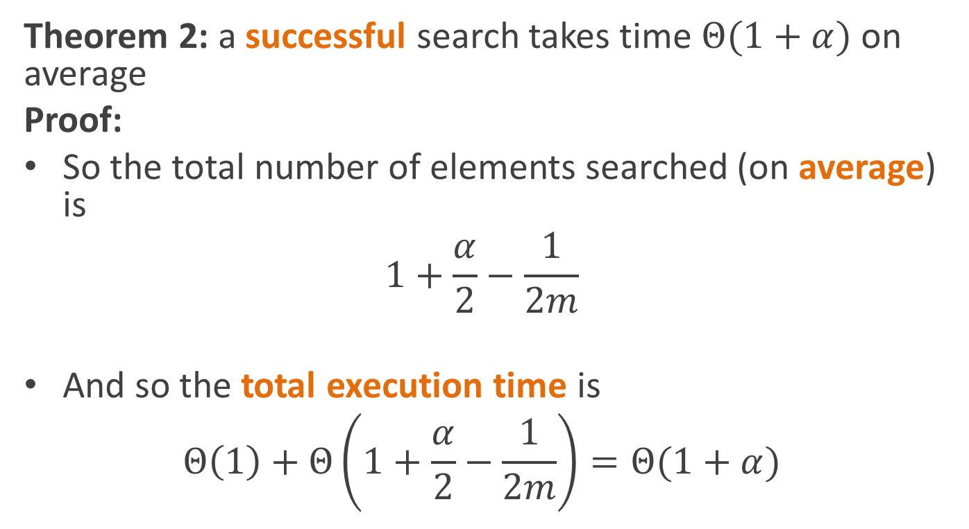
Average-case performance
Theorem 2: a successful search takes time $Θ(1+α)$ on average
Proof:
So the total number of elements searched (on average) is
$$1+\frac{α}{2}−\frac{1}{2m}$$
And so the total execution time is
$$Θ\left(1\right)+Θ\left(1+\frac{α}{2}−\frac{1}{2m}\right)=Θ(1+α)$$

Slide 32
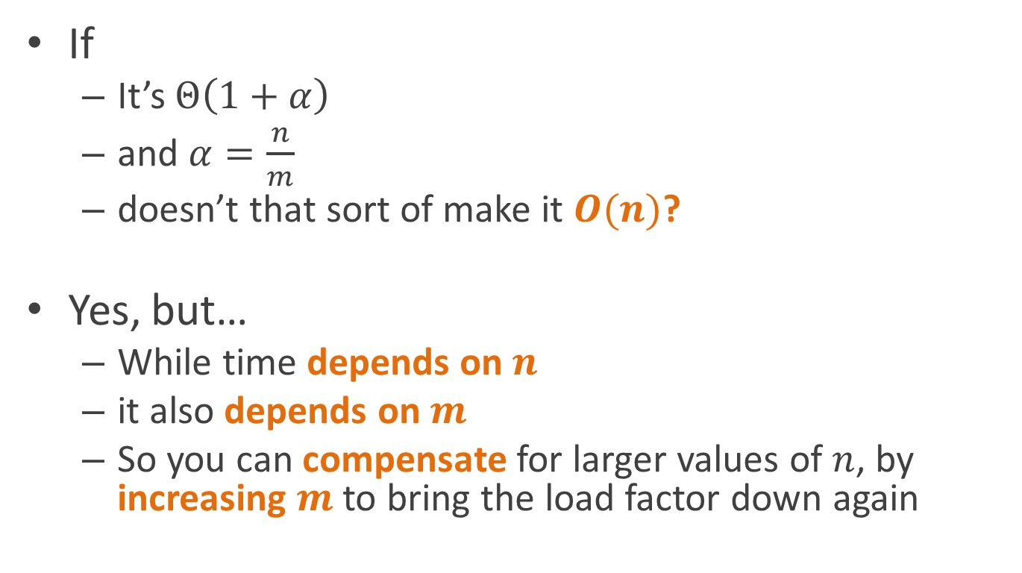
But wait…
If
  It’s $Θ\left(1+α\right)$
  and $α=\frac{n}{m}$
  doesn’t that sort of make it $O(n)$?
Yes, but…
  While time depends on $n$
  it also depends on $m$
  So you can compensate for larger values of $n$, by increasing $m$ to bring the load factor down again

Slide 33
But wait…
So really, it just means that you need to make sure the table is big enough for the number of entries you’re going to have in it
In fact, it’s possible to make tables that grow automatically to keep the load factor down
  We’ll talk about this toward the end of the quarter

Slide 34
Open addressing
Instead of using a linked list
We can resolve collisions by trying successive locations in the hash table
Important: this requires that the array be an array of key/value pairs

Slide 35
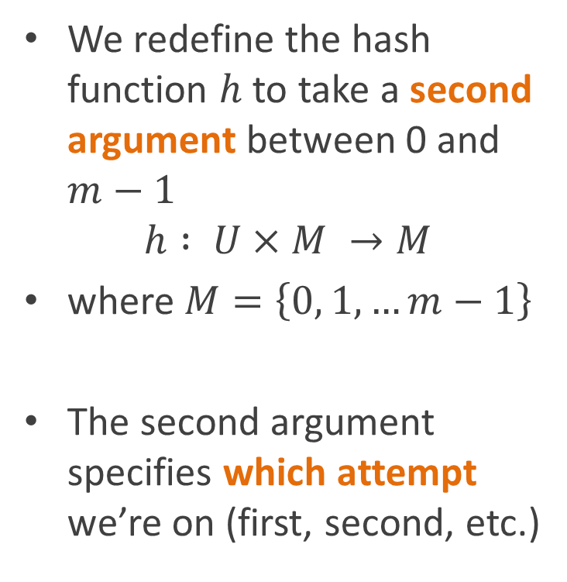
Open addressing
We redefine the hash function $h$ to take a second argument between 0 and $m−1$
$$h : U×M →M$$
where $M=\left\{0, 1, …m−1\right\}$
The second argument specifies which attempt we’re on (first, second, etc.)

Slide 36
Open addressing
void Store(key, value) {
for (int i = 0; i<m; i++) {
int j = h(key, i);
if (array[j].key == key) {
array[j].value = value;
return;
} else if (array[j].key==null) {
array[j].key = key;
array[j].value = value;
return;
}
}
throw new Exception(“table full”);
}

Slide 37
Open addressing
void Store(key, value) {
for (int i = 0; i<m; i++) {
int j = h(key, i);
if (array[j].key == key) {
array[j].value = value;
return;
} else if (array[j].key==null) {
array[j].key = key;
array[j].value = value;
return;
}
}
throw new Exception(“table full”);
}
Question: why do we give up after m iterations?

Slide 38
Open addressing
void Store(key, value) {
for (int i = 0; i<m; i++) {
int j = h(key, i);
if (array[j].key == key) {
array[j].value = value;
return;
} else if (array[j].key==null) {
array[j].key = key;
array[j].value = value;
return;
}
}
throw new Exception(“table full”);
}
Because the array only has m elements

Slide 39
Open addressing
void Store(key, value) {
for (int i = 0; i<m; i++) {
int j = h(key, i);
if (array[j].key == key) }
array[j].value = value;
return;
} else if (array[j].key==null) {
array[j].key = key;
array[j].value = value;
return;
}
}
throw new Exception(“table full”);
}
So we’ve tried them all

Slide 40
Open addressing
void Lookup(key) {
for (int i = 0; i<m; i++)
{
int j = h(key, i);
if (array[j].key == key)
return array[j].value;
if (array[j].key == null;
return null;
}
return null;
}

Slide 41
Probe sequences
The two-argument hash function defines a whole sequence of locations to check
Called the probe sequence
In practice, the two-argument hash function is built from
  A one-argument hash function
  And some extra magic

Slide 42
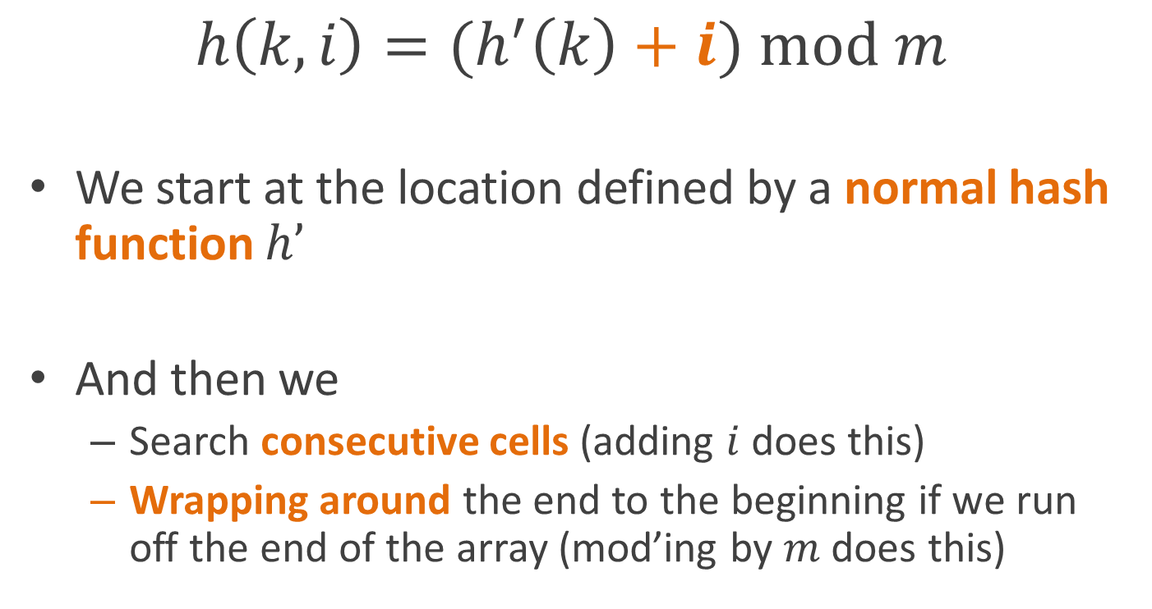
Linear probing
$$h\left(k,i\right)={(h}^{′}\left(k\right)+i) \text{mod} m$$
We start at the location defined by a normal hash function $h’$
And then we
  Search consecutive cells (adding $i$ does this)
  Wrapping around the end to the beginning if we run off the end of the array (mod’ing by $m$ does this)

Slide 43
Clustering
Linear probing produces long runs of occupied cells
Any new key that hashes to one of those runs has to go all the way at the end of it
So performance isn’t very good

Slide 44
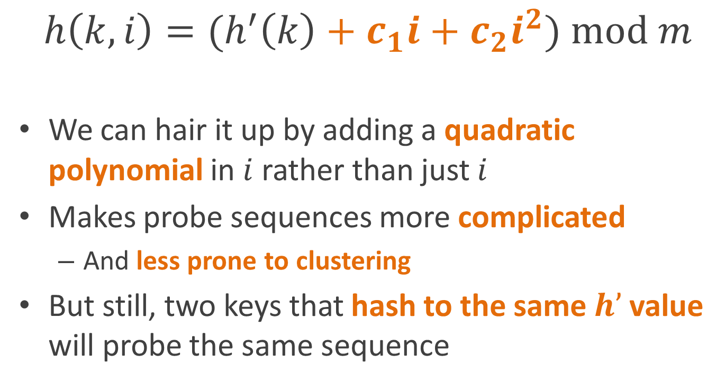
Quadratic probing
$$h\left(k,i\right)={(h}^{′}\left(k\right)+c_{1}i+c_{2}i^{2}) \text{mod} m$$
We can hair it up by adding a quadratic polynomial in $i$ rather than just $i$
Makes probe sequences more complicated
  And less prone to clustering
But still, two keys that hash to the same $h’$ value will probe the same sequence

Slide 45
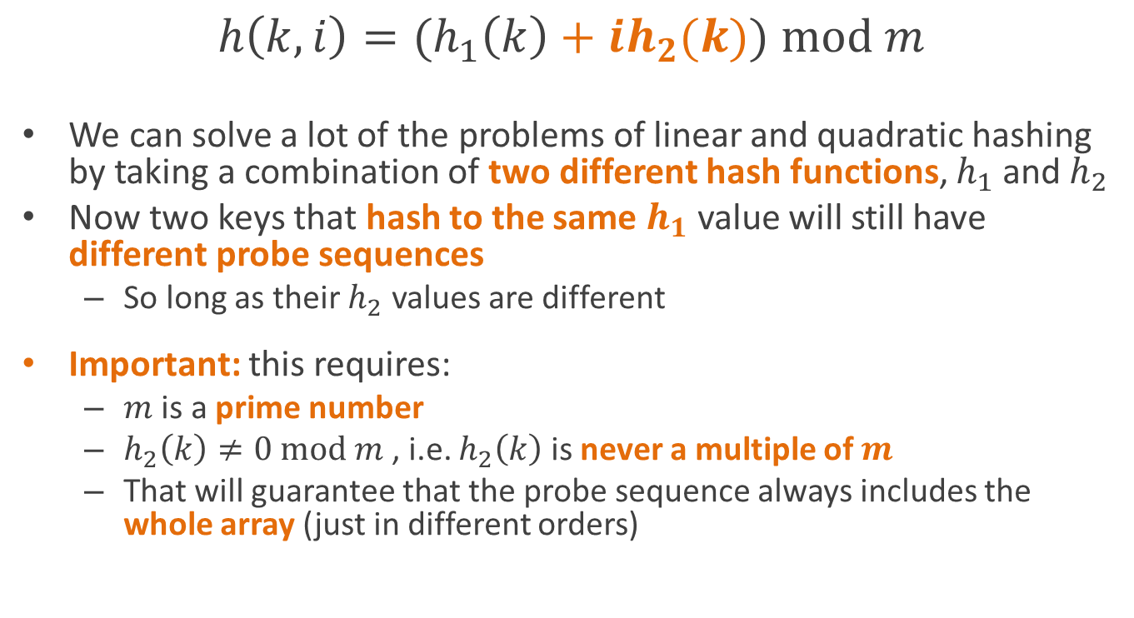
Double hashing
$$h\left(k,i\right)=(h_{1}\left(k\right)+ih_{2}(k)) \text{mod} m$$
We can solve a lot of the problems of linear and quadratic hashing by taking a combination of two different hash functions, $h_{1}$ and $h_{2}$
Now two keys that hash to the same $h_{1}$ value will still have different probe sequences
  So long as their $h_{2}$ values are different
Important: this requires:
  $m$ is a prime number
  $h_{2}\left(k\right)≠0 mod m$, i.e. $h_{2}\left(k\right)$ is never a multiple of $m$
  That will guarantee that the probe sequence always includes the whole array (just in different orders)

Slide 46
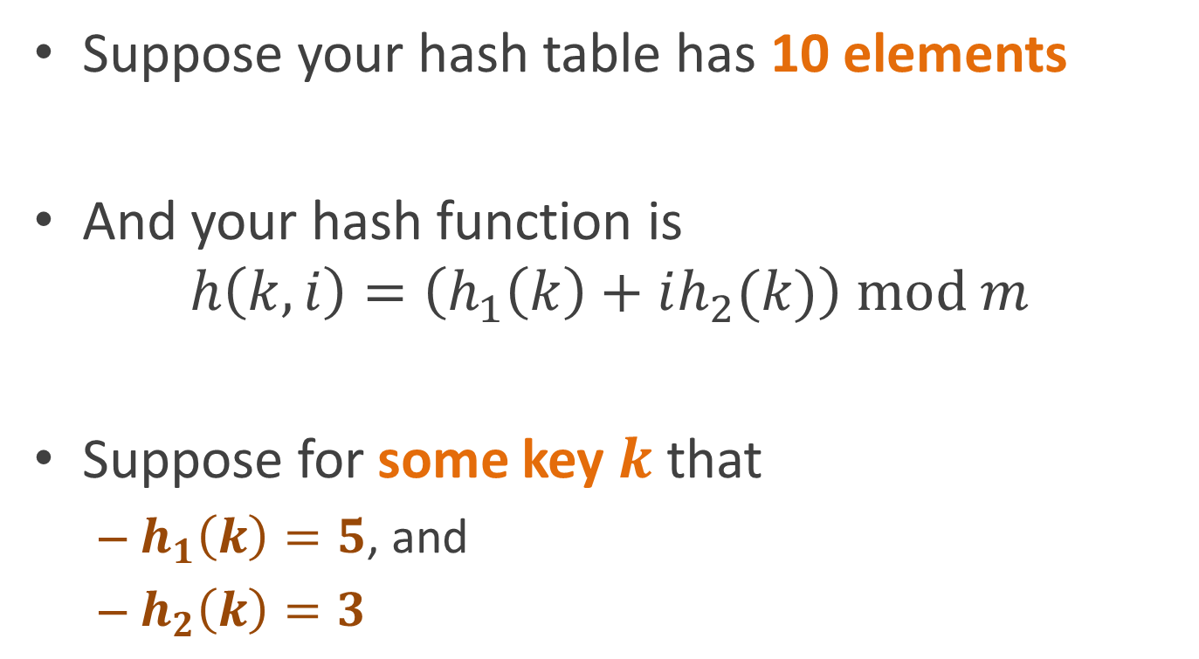
Why do prime numbers matter?
Suppose your hash table has 10 elements
And your hash function is
$h\left(k,i\right)=\left(h_{1}\left(k\right)+ih_{2}(k)\right) mod m$
Suppose for some key $k$ that
  $h_{1}\left(k\right)=5$, and
  $h_{2}\left(k\right)=3$

Slide 47
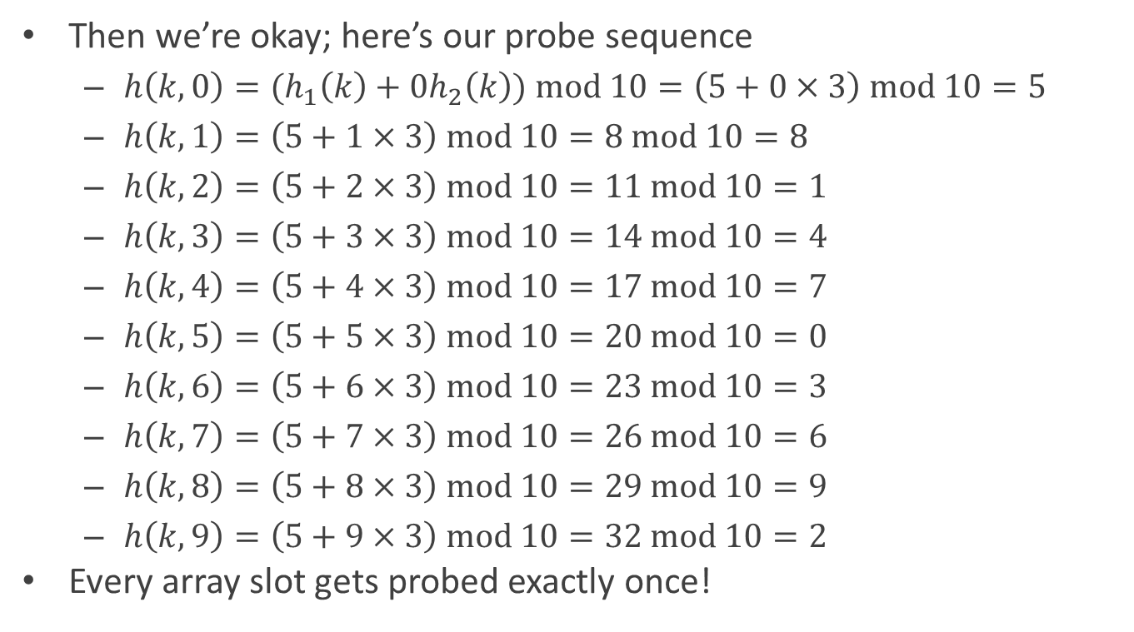
Why do prime numbers matter?
Then we’re okay; here’s our probe sequence
  $h\left(k,0\right)={(h}_{1}\left(k\right)+0h_{2}\left(k\right)) mod 10=\left(5+0×3\right) mod 10=5$
  $h\left(k,1\right)=\left(5+1×3\right) mod 10=8 mod 10=8$
  $h\left(k,2\right)=\left(5+2×3\right) mod 10=11 mod 10=1$
  $h\left(k,3\right)=\left(5+3×3\right) mod 10=14 mod 10=4$
  $h\left(k,4\right)=\left(5+4×3\right) mod 10=17 mod 10=7$
  $h\left(k,5\right)=\left(5+5×3\right) mod 10=20 mod 10=0$
  $h\left(k,6\right)=\left(5+6×3\right) mod 10=23 mod 10=3$
  $h\left(k,7\right)=\left(5+7×3\right) mod 10=26 mod 10=6$
  $h\left(k,8\right)=\left(5+8×3\right) mod 10=29 mod 10=9$
  $h\left(k,9\right)=\left(5+9×3\right) mod 10=32 mod 10=2$
Every array slot gets probed exactly once!

Slide 48

Why do prime numbers matter?
But now suppose that for some key $k$ that
  $h_{1}\left(k\right)=5$, and
  $h_{2}\left(k\right)=5$

Slide 49
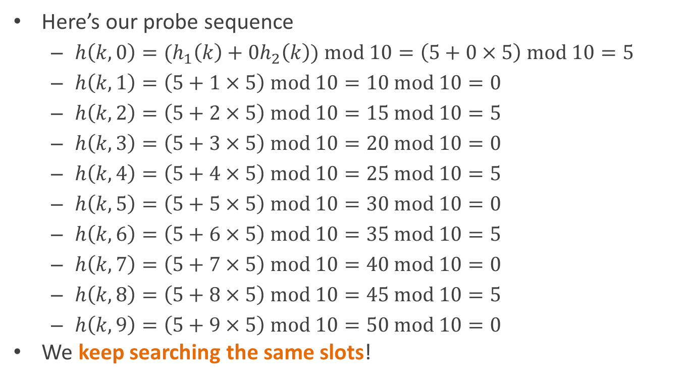
Why do prime numbers matter?
Here’s our probe sequence
  $h\left(k,0\right)={(h}_{1}\left(k\right)+0h_{2}\left(k\right)) mod 10=\left(5+0×5\right) mod 10=5$
  $h\left(k,1\right)=\left(5+1×5\right) mod 10=10 mod 10=0$
  $h\left(k,2\right)=\left(5+2×5\right) mod 10=15 mod 10=5$
  $h\left(k,3\right)=\left(5+3×5\right) mod 10=20 mod 10=0$
  $h\left(k,4\right)=\left(5+4×5\right) mod 10=25 mod 10=5$
  $h\left(k,5\right)=\left(5+5×5\right) mod 10=30 mod 10=0$
  $h\left(k,6\right)=\left(5+6×5\right) mod 10=35 mod 10=5$
  $h\left(k,7\right)=\left(5+7×5\right) mod 10=40 mod 10=0$
  $h\left(k,8\right)=\left(5+8×5\right) mod 10=45 mod 10=5$
  $h\left(k,9\right)=\left(5+9×5\right) mod 10=50 mod 10=0$
We keep searching the same slots!

Slide 50
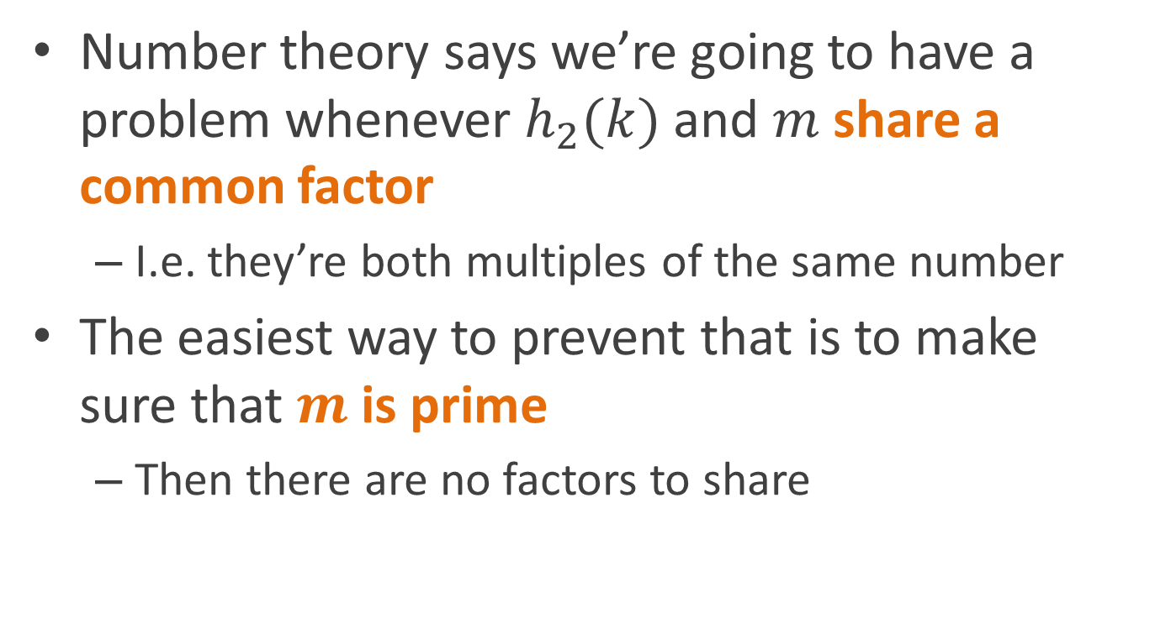
Why do prime numbers matter?
Number theory says we’re going to have a problem whenever $h_{2}(k)$ and $m$ share a common factor
  I.e. they’re both multiples of the same number
The easiest way to prevent that is to make sure that $m$ is prime
  Then there are no factors to share

Slide 51
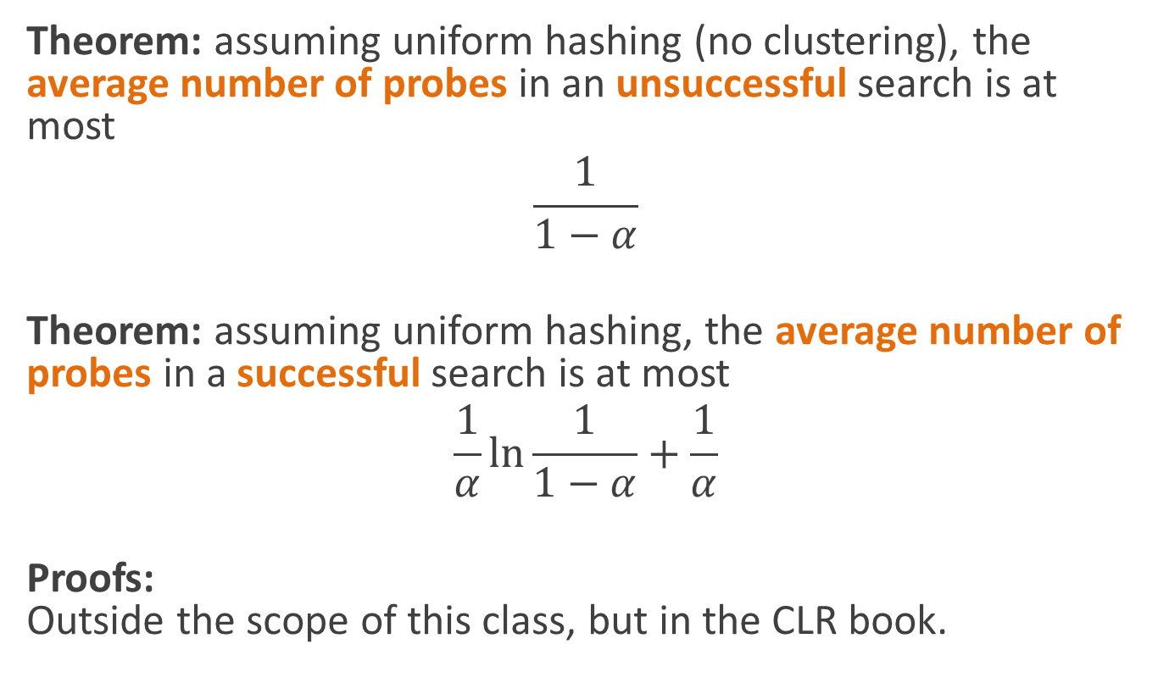
Performance of open addressing
Theorem: assuming uniform hashing (no clustering), the average number of probes in an unsuccessful search is at most
$$\frac{1}{1−α}$$
Theorem: assuming uniform hashing, the average number of probes in a successful search is at most
$$\frac{1}{α}\ln{\frac{1}{1−α}+\frac{1}{α}}$$
Proofs:
Outside the scope of this class, but in the CLR book.

Slide 52
Variations on the interface
Sometimes we think of a hash table as just holding objects
  Not key/value pairs
Then the hash table just stores objects based on some hash we can compute from the object
  C# calls these “HashSets”
The CLR book assumes this interface

Slide 53
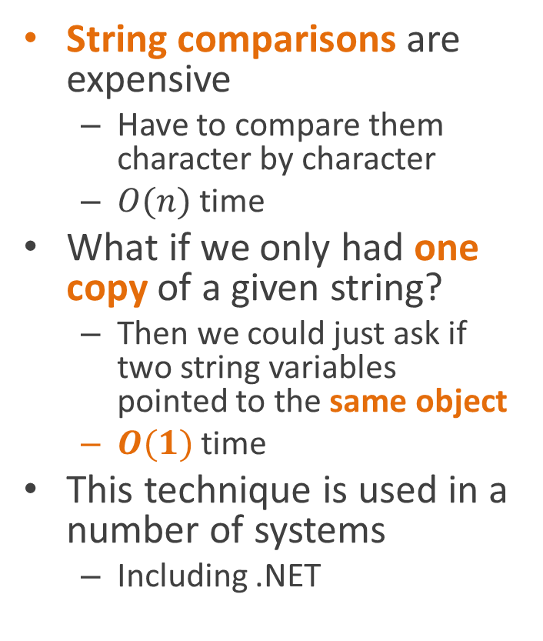
Example: canonicalizing strings
String comparisons are expensive
  Have to compare them character by character
  $O(n)$ time
What if we only had one copy of a given string?
  Then we could just ask if two string variables pointed to the same object
  $O(1)$ time
This technique is used in a number of systems
  Including .NET
string MakeString(char[] chars) {
string probe =
StringTable.Lookup(chars);
if (probe != null)
return probe;
else {
string newString =
new string(chars);
StringTable.Add(newString);
return newString;
}
}

Slide 54
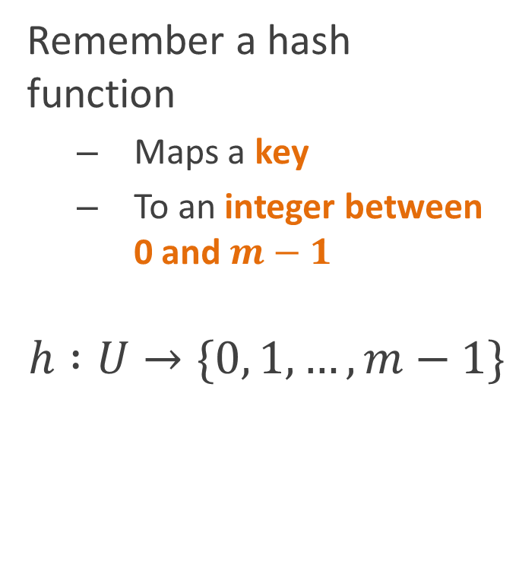
Designing hash functions
Remember a hash function
  Maps a key
  To an integer between 0 and $m−1$
$$h :U→\{0, 1,…, m−1\}$$
We want a hash function that:
Is easy (read: fast) to compute
Has the statistical property that
  For a randomly chosen key
  Each possible hash value is equally likely

Slide 55
Designing hash functions
Break problem up into two parts:
Map the key to an integer (often a large one)
  E.g. add all the characters of a string together
  This gives us an integer, but usually with the wrong range and wrong statistical properties
Remap the integer to a hash value in the right range with the right statistical properties

Slide 56
Mapping to a large integer
Easy for primitive objects
  Integers, characters, Booleans, pointers, etc.
  Just take the bits of the representation and cast them to an int
    int i = (int)whatever;
For compound objects (hashing on object identity)
  Use address of object in memory (C, C++)
  Assign serial number in some hidden field of the object (Java, C#)
For compound objects (hashing on object contents)
  Convert individual fields to integers
  Combine integers into a bigger, or at least different integer
Great! But how do we combine the hashes of the different fields?
  We’ll look at a couple of ways of doing this
  We’ll assume the objects are arrays, but record structures, linked lists, etc. all work the same general way

Slide 57
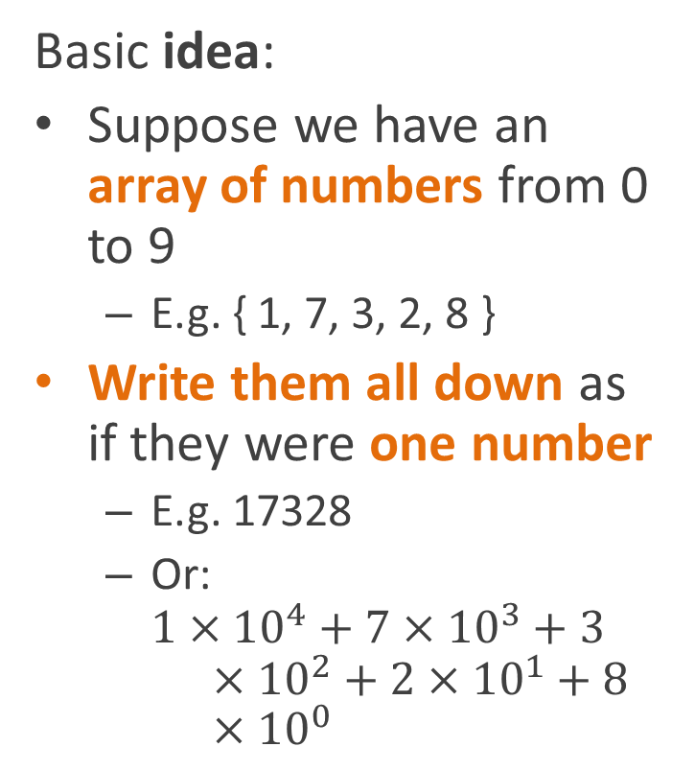
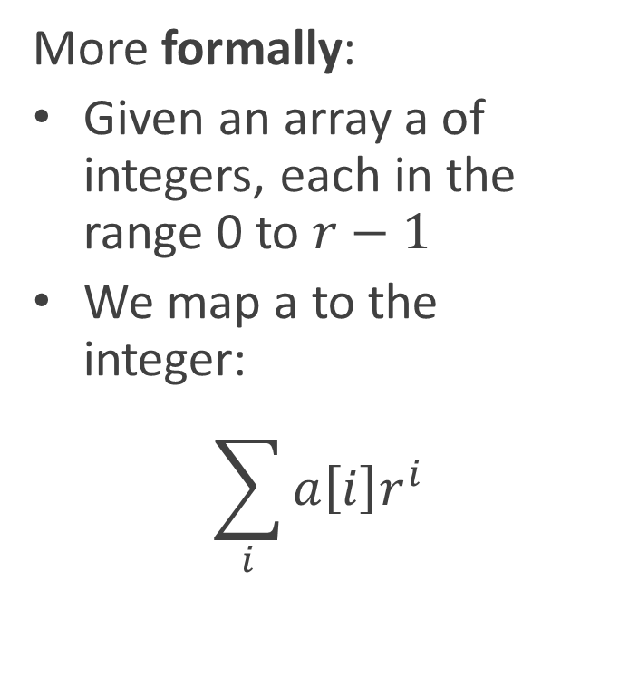
Radix notation
Basic idea:
Suppose we have an array of numbers from 0 to 9
  E.g. { 1, 7, 3, 2, 8 }
Write them all down as if they were one number
  E.g. 17328
  Or:
  $1×{10}^{4}+7×{10}^{3}+3×{10}^{2}+2×{10}^{1}+8×{10}^{0}$
More formally:
Given an array a of integers, each in the range 0 to $r−1$
We map a to the integer:
$$\sum_{i}{a\left[i\right]r^{i}}$$

Slide 58
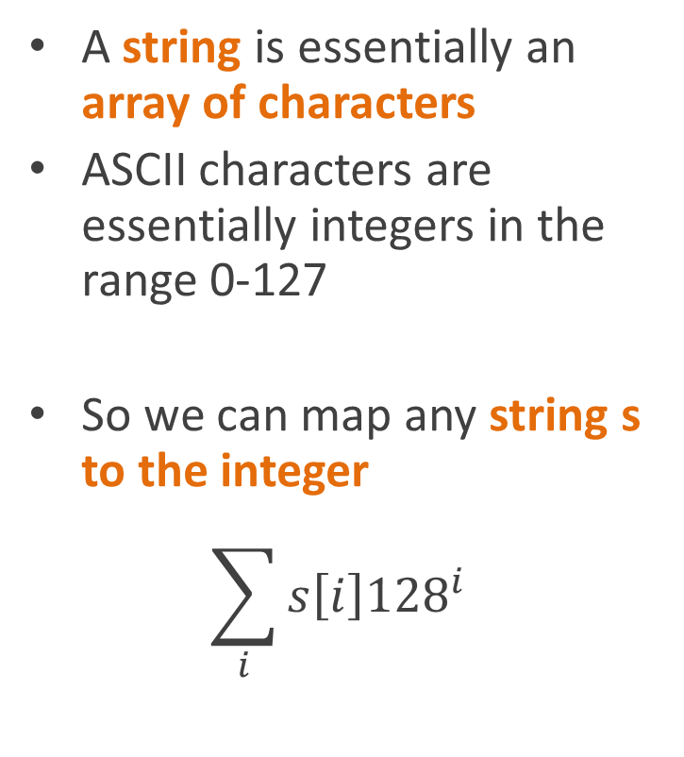
Radix notation
A string is essentially an array of characters
ASCII characters are essentially integers in the range 0-127
So we can map any string s to the integer
$$\sum_{i}{s\left[i\right]{128}^{i}}$$
That makes for a very large integer
  Overflows 32 bits after 4 characters
But sometimes it’s practical
We’re mostly just mentioning radix notation because it’s the method the CLR book mentions

Slide 59
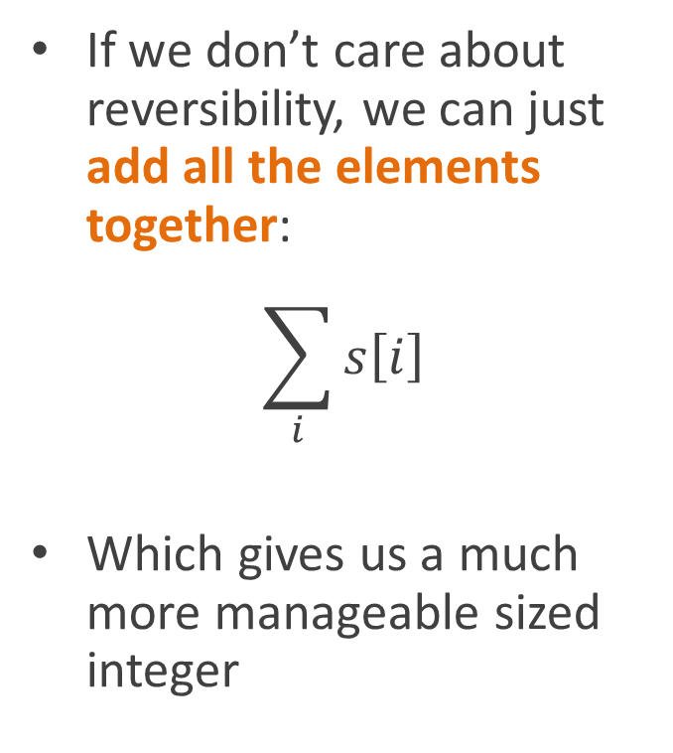
Summing
Radix notation has the possibly useful property of being 1:1
  There’s a unique integer for every string (or array, or whatever)
  And vice-versa
But who cares if we’re hashing?
  We’re just going to run it through the hash function, which isn’t 1:1 anyway
If we don’t care about reversibility, we can just add all the elements together:
$$\sum_{i}{s\left[i\right]}$$
Which gives us a much more manageable sized integer

Slide 60
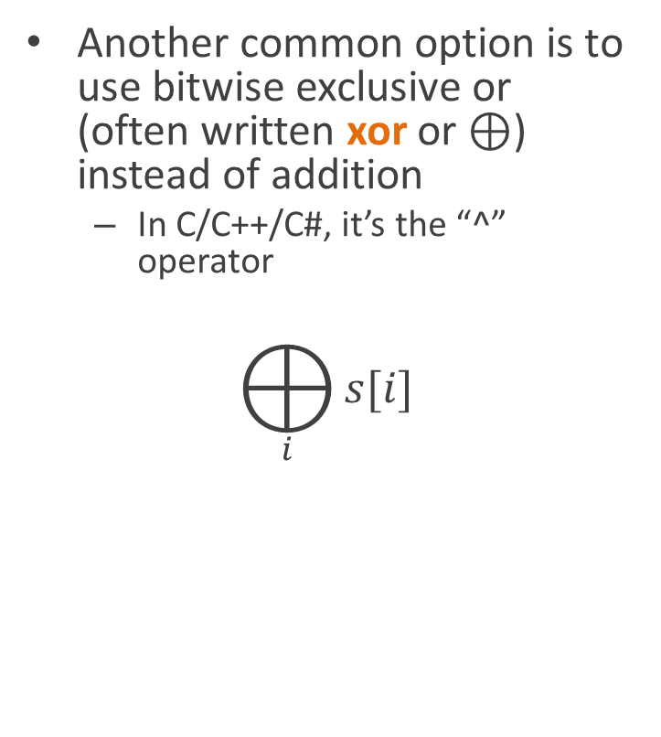
Exclusive-or’ing
Another common option is to use bitwise exclusive or (often written xor or $⊕$) instead of addition
  In C/C++/C#, it’s the “^” operator
$$⨁_{i}{s[i]}$$
int XorString(string s) {
int result = 0;
foreach (char c in s)
result = result ^ c;
return result;
}
Bitwise xor has a lot of the nice properties of addition, but guarantees the result is the same number of bits as the input
  Which is sometimes useful

Slide 61
XOR (1-bit case)
The XOR of two bits is:
  1, if one or the other of the inputs is 1
    But not both
  0, otherwise
Ways of thinking about XOR
  1 if the inputs are different, 0 otherwise
  Add the two bits (in base 2) and throw away the carry
  Flip the first bit if the second is 1
  Flip the second bit if the first is 1
input | 0 | 1
0 | 0 | 1
1 | 1 | 0

Slide 62
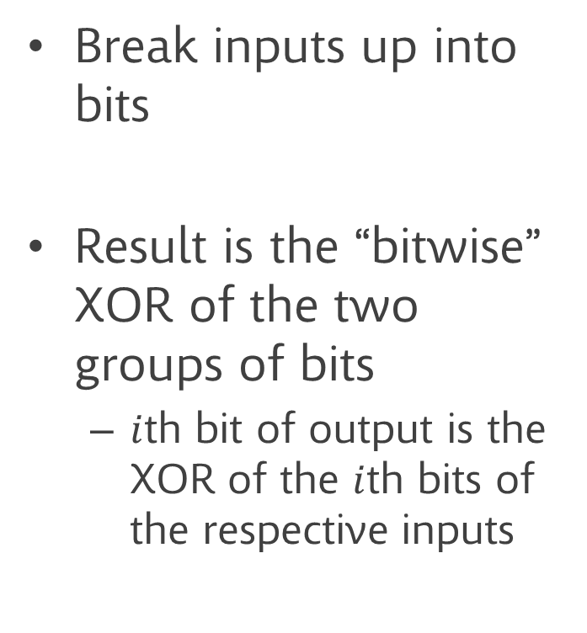
XOR (n-bit case)
Break inputs up into bits
Result is the “bitwise” XOR of the two groups of bits
  $i$th bit of output is the XOR of the $i$th bits of the respective inputs
Inputs | 00 | 01 | 10 | 11
00 | 00 | 01 | 10 | 11
01 | 01 | 00 | 11 | 10
10 | 10 | 11 | 00 | 01
11 | 11 | 10 | 01 | 00

Slide 63
Shifting
Summing and xoring have two potential problems
  The integer might be too small
  If you swap two characters (or array elements, or whatever), you get the same integer back
    Potentially more hash collisions
Basically a variant on radix notation
We can fix that by doing a left shift (equivalent of multiplying by 2) each time we add in another element
Ideally, this should be a circular shift (where bits that overflow from the left side of the word wrap the right side)
  Shift left 1 bit
  Shift right 31 bits (assuming 31 bit int)
  Or them together
int StringToInt(string s) {
uint result = 0;
foreach (char c in s) {
var cshift = result <<1 | result>>31;
result = cshift ^ c;
}
return result;
}

Slide 64
Hashing to a small integer
Now we want to hash the big integer down to
  A small integer in the range: 0 … m
  Such that each output is equally common
    So that keys are equally distributed in buckets

Slide 65
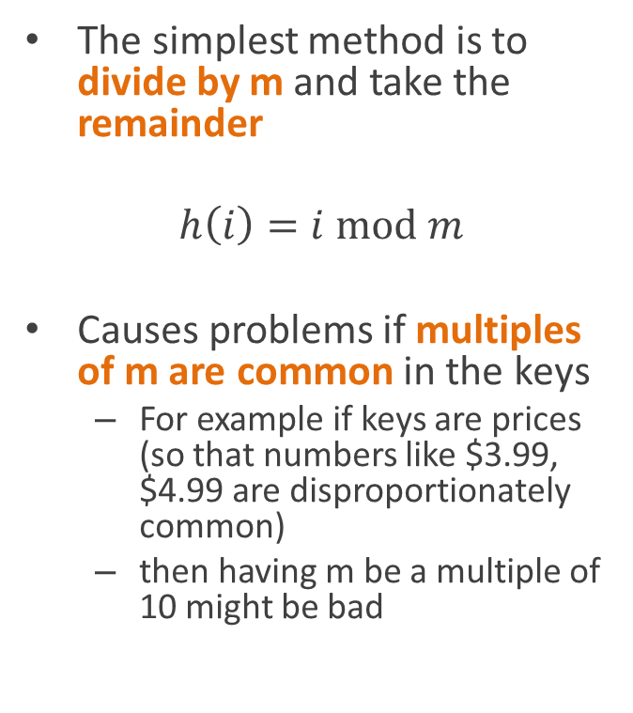
Division method
The simplest method is to divide by m and take the remainder
$$h\left(i\right)=i \text{mod} m$$
Causes problems if multiples of m are common in the keys
  For example if keys are prices (so that numbers like $3.99, $4.99 are disproportionately common)
  then having m be a multiple of 10 might be bad
Powers of 2 can also be problematic
  All numbers with the same low-order bits map to the same hash
Conventional wisdom is to choose m to be a prime number

Slide 66
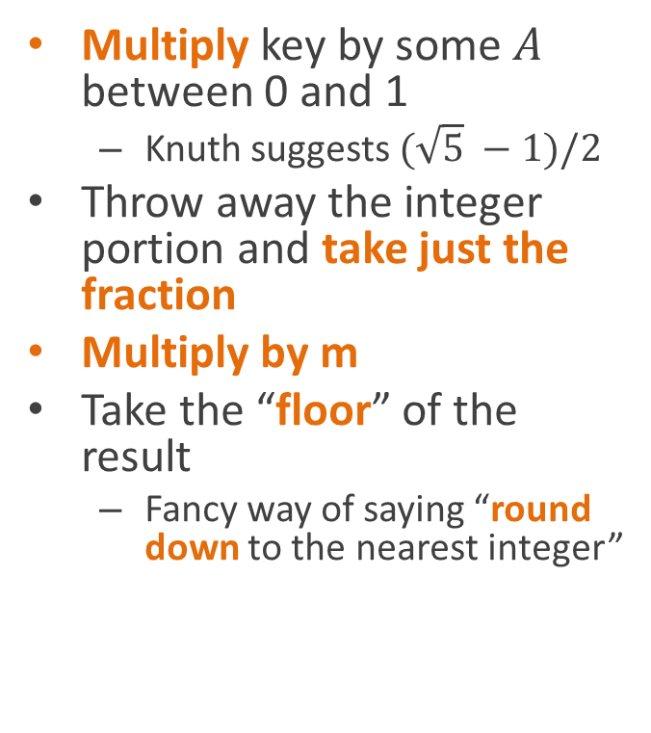
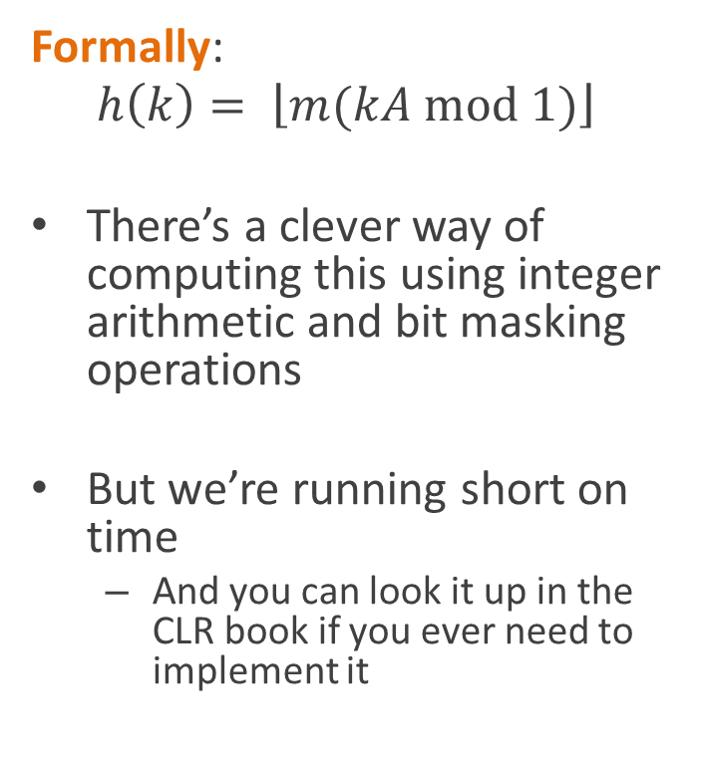
Multiplication method
Multiply key by some $A$ between 0 and 1
  Knuth suggests $(\sqrt{5} −1)/2$
Throw away the integer portion and take just the fraction
Multiply by m
Take the “floor” of the result
  Fancy way of saying “round down to the nearest integer”
Formally:
$$h\left(k\right)= \left\lfloor m(kA \text{mod} 1)\right\rfloor$$
There’s a clever way of computing this using integer arithmetic and bit masking operations
But we’re running short on time
  And you can look it up in the CLR book if you ever need to implement it

Slide 67
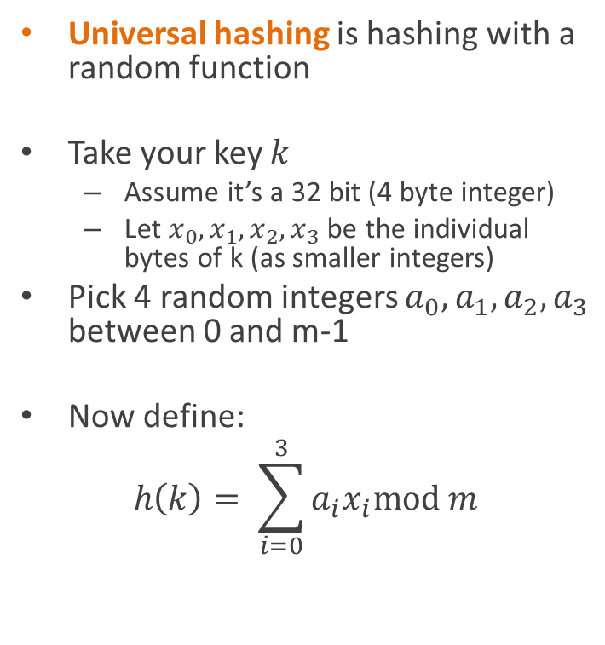
Universal hashing
All hash functions have collisions
So no matter what hash function you choose, there’s some set of keys that will make it perform badly
You can mitigate this by choosing your hash function randomly when you make the hash table
Universal hashing is hashing with a random function
Take your key $k$
  Assume it’s a 32 bit (4 byte integer)
  Let $x_{0},x_{1},x_{2}, x_{3}$ be the individual bytes of k (as smaller integers)
Pick 4 random integers $a_{0}, a_{1},a_{2},a_{3}$ between 0 and m-1
Now define:
$$h\left(k\right)= \sum_{i=0}^{3}{a_{i}x_{i}\text{mod} m}$$

Slide 68
Perfect hashing
Sometimes, there’s a small, fixed, set of objects you want to hash
  E.g. a compiler keeping track of keywords of its language (like if, else, switch)
Perfect hashing is when you choose a hash function in advance that you know will be collision-free for your keys
How do we find a perfect hash function?
See the discussion in the book, but in the end, it will amount to
  Writing an algorithm
  To try different hash functions
  Until it finds one that’s perfect

Slide 69
Hashing in C#
The standard C# libraries provide built-in hash table implementations
  System.Collections:
    HashTable
  System.Collections.Generic:
    Dictionary<KeyT, VT>
These both use the GetHashCode() method virtual function, which is defined in the Object class
  Should return a 32 bit hash
  Hash tables themselves will compress it down to a small integer
So if you want to use the built-in hash tables you need to override the GetHashCode() method for you classes
A common thing to do is to just call GetHashCode() on all the fields of your object, and XOR all the results together

Slide 70
Other applications of hash functions

Slide 71
Simple example: cache memory
Your CPU is processing an instruction every nanosecond or so
However your RAM takes 50+ ns to do a read or write operation
What to do?
CPU
Cache
RAM

Slide 72
Simple example: cache memory
Caching!
  Buy a small amount of very fast RAM
  Use it to build a hardware hash table
    Using low-order bits of memory address as the hash code
  Remember recently access locations in RAM
  Throw away old data when we have a collision
First memory reference is very expensive
  Subsequent references to the same location run fast
CPU
Cache
RAM

Slide 73
Other applications of “hash-like” functions
Error detecting codes
  Used to detect (or even correct) recording or transmission errors
Cryptographic hash functions
  A compact “signature” for a piece of data
    Much smaller than original document
    Very unlikely to have the same signature as another document

Slide 74
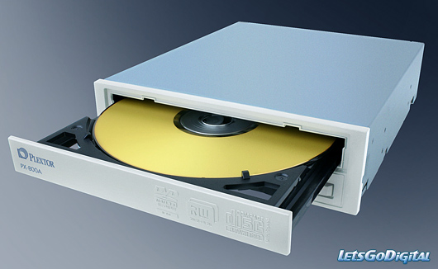
Error detecting codes
Checksums
  Add all the bytes of data together
  Store the sum along with the data
When reading data back from disk
  Recompute the checksum
  Compare it to the stored checksum
  If they don’t match, there was a recording error

Slide 75
Error detecting codes
There are many sophisticated error detection codes in use
  Cyclic Redundancy Check (CRC)
    Used in many disk drives
  Reed-Solomon codes
    Used in CD-ROMs

Slide 76
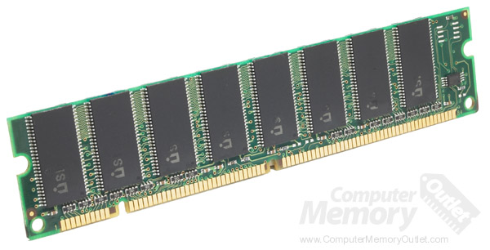
Parity
Parity is a simpler, faster algorithm, used for checking data in RAM
One additional bit is stored: the XOR of all the other bits
  1 if there are an odd number of 1 bits in the byte
  0 if there are an even number of 1-bits in the byte
  Can be thought of as a 1-bit checksum
Lets you detect any single-bit error

Slide 77
Error-Correcting Codes
High-end computers such as serves store multiple parity bits with each byte
  The parity of all bits in the byte
  The parity of just the first 4 bits
  The parity of bits 1 and 2, and 5 and 6
Examing which of these parity checks fails lets you
  Detect double-bit errors
  Correct single-bit errors

Slide 78
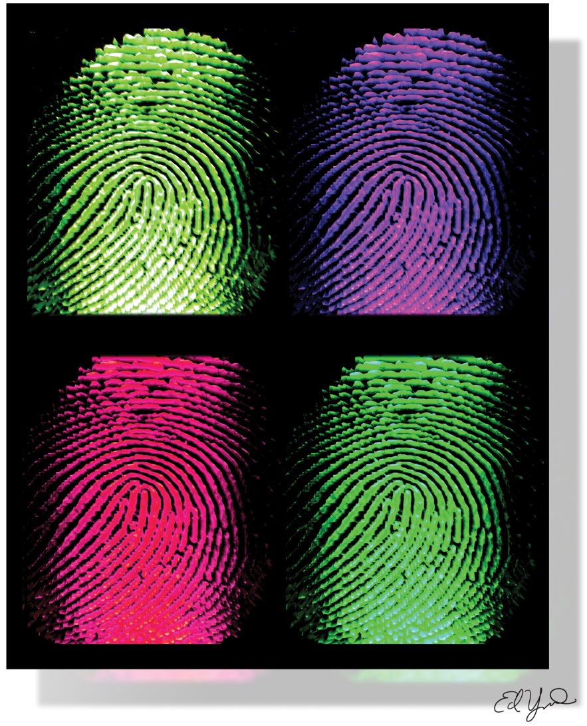
Cryptographic hashes
Cryptographic hashes are designed to make it very hard to deliberately make a data object that has the same hash code as another object
Used as compact “fingerprints” for larger documents
Popular algorithms
  MD4/MD5
  SHA-1, SHA-256, SHA-512

Slide 79
Uses
Tamper detection
  Used for digitally signing messages
  Used e.g. in bittorrent to ensure data received matches the torrent
Identifiers for documents
Saving transmission bandwidth
  Send server the hash of a file before sending the file
  Server tells you if it already has the file

Slide 80
Single-instance stores
Companies are rolling out cloud services for music
  Store you music “in the cloud” (i.e. on servers)
  Stream it from any machine you like
Amazon, google, Apple, etc.
That’s a lot of data!
  How do they make that work?
Key idea: many people, few songs
  Two people who bought the same song from the same provider have exactly the same file
  Before storing in the cloud,
  Check to see if the server already has a copy of the same file
Only one copy of each song is stored in the cloud
Saves both memory and bandwidth

Slide 81
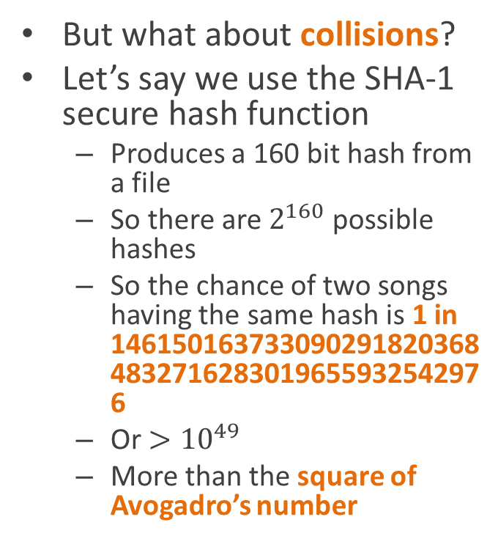
Basic algorithm
To add a file:
Client sends hash of file to server
Server checks hash table
  Hash already present?
    Server adds pointer to existing file to user’s directory
    No data stransmitted
  Not present?
    New file
    Client transmits full file
    Server adds file to hash table
But what about collisions?
Let’s say we use the SHA-1 secure hash function
  Produces a 160 bit hash from a file
  So there are $2^{160}$ possible hashes
  So the chance of two songs having the same hash is 1 in 1461501637330902918203684832716283019655932542976
  Or $>{10}^{49}$
  More than the square of Avogadro’s number

Slide 82
Dropbox’s privacy policy
A complaint against Dropbox for deceptive trade practices was filed with the FTC in 2011
It’s was filed by a Ph.D. student who
He claimed
  Dropbox’s claims that its employees couldn’t read your files were false
  Because they were using a single-instance store
But dropbox didn’t tell people that they were using a single-instance store
  So how did he know?
Any why would it matter to a user?

Slide 83
Reading
CLR chapter on Hash Tables

